Slide 1
IST659 Data Admin Concepts and Database Management
Week 3
Hernando Hoyos
Modeling Data II

Slide 2
Acknowledgements and caveat
These course materials draw liberally, with permission, from the following sources:
IST659 classes taught by Prof. Bei Yu
IST659 classes taught by Prof. Susan Dischiave
IST 659 classes taught by Prof. Yun Huang
Instructor resources provided by our text book ”Modern Database Management”
Caveat (beware): At best, PowerPoint slides are only a pale imitation of the entirety of a class meeting. In IST659 in particular, the lectures will cover topics beyond what appears in these slides. Don’t rely on them as a substitute for attending class.

Slide 3
Announcements
Assigned today
Lab 2
Due today
Project Ideas
Project ideas are not yet commented. (will see feedback tonight)
Common problem:
Not describing a data management problem
Think about the purpose of the database, who are the users, in what way, and what questions do they need to answer?
The project proposal guidelines will help you think along this line.

Slide 4
Review of Last Lecture
Business Rules
Entity Relationship Model (3 Key things)
Entities
Different kinds of attributes
Required (boldface) vs. optional attributes
Simple vs. composite attributes
Single-valued vs. multi-valued attributes
Stored vs. derived attributes
Identifier attributes
Relationships
Attributes
Degree of relationships
Cardinality of Relationships & Cardinality Constraint
Associative entities
Relational Database

Slide 5
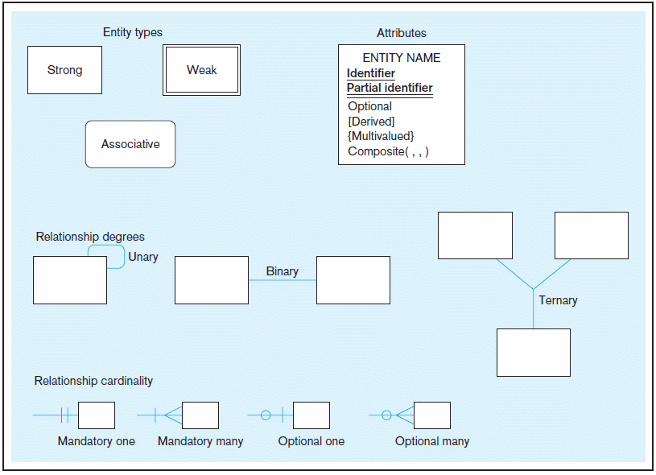
Basic E-R notation (Figure 2-2)
Entity symbols
Attribute symbols
A special entity that is also a relationship
Relationship symbols
Relationship degrees specify number of entity types involved
Relationship cardinalities specify how many of each entity type is allowed
© 2013 Pearson Education, Inc. Publishing as Prentice Hall
Notes:
8

Slide 6
Cardinality Constraints
A
B
A
B
A
B
Many-to-many
Many-to-one
One-to-one
Multiplicity of binary relationship set R between entity sets A and B
Example: For “One-to-one,” an entity in A is associated with at most one entity in B, and vice versa. (A = B = “person”, R = “married-to”)

Slide 7
Modeling the relationships
How do assumptions affect the cardinality of relationships?
Step 1: 1:1, 1:M or M:N?
Step 2: Optional or Mandatory?

Slide 8
Step 1: Cardinality Constraints in Binary Relationships
is assigned to 1:1
Employee
Office
Contains 1:M
Order
Orderline
registers M:N
Course section
Student

Slide 9
Step 2: Mandatory or Optional Modality Constraints
Is assigned to 1:1
Employee
Office
Contain 1:M
Order
Orderline
registerM:N
Course section
Student

Slide 10
Conceptual Model
(E-R Model)
→
Relational Database

Slide 11
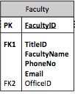
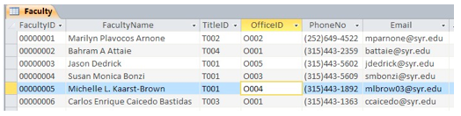
Converting an Entity (with attributes) to a Table (with columns)
How do we map ER model to relational data models?
Entity -> Table
Entity Instance -> Row
Attribute -> Column
Visio Diagram
Access Table

Slide 12
Mapping Relationships into Relational Tables
is assigned to 1:1
Employee
Office
Contains 1:M
Order
Orderline
registers M:N
Course section
Student
There will be many options (including bad options) to create the tables, which one should the database analyst take?

Slide 13
Foreign key in 1:1 relationship
Is assigned to 1:1
Employee
Office
Employee
EmployeeID
EmployeeFirstName
EmployeeLastName
EmployeeOfficeID
Office
OfficeID
BuildingNo
RoomNo
PhoneNo
A foreign key is the primary key of another table.
Think about this:
Which side do we add the other entity’s primary key to?
What if the relationship has some attributes that do not belong to either entity?

Slide 14
Attributes on 1:1 binary relationships
If storing current office assignment only
Is assigned to 1:1
Employee
Office
If storing office assignment history
Office Assignment
Employee
Office

Slide 15
Attributes on 1:1 binary relationship (cont.)
Office Assignment
Employee
Office
OfficeAssignment
AssignmentID
EmployeeName
OfficeNumber
StartDate EndDate
PK FK
FK

Slide 16
Foreign key in 1:M relationship must be on the M side.
Contains 1:M
Order
Orderline
Order
OrderID
OrderDate
TotalAmt
Orderline
OrderlineID
ItemID
ItemQty
UnitPrice
OrderID
PK
PK
FK

Slide 17
→ Associative entity & Two 1:M Relationships
M:N Relationship
registers M:N
Student
Class
Student
Class
registration

Slide 18
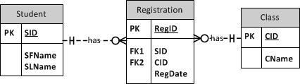
Associative entity
The registration table has composite primary key. You can create a surrogate key “RegID” for convenience.

Slide 19
ER Model:
Weak Entity & Identifying Relationship

Slide 20
Weak Entity
Weak entity :
Does not have enough attributes on their own to form a key.
They need to “borrow” attributes from other entity sets to form a key.

Slide 21
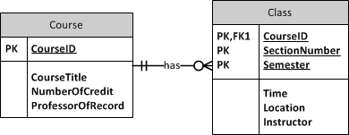
Identifying relationships
Part of the weak entity’s primary key is a foreign key, i.e. a primary key from another table.
Notes:
Identifying relationship at the top
Non-identifying relationship at the bottom

Slide 22
Identifying relationships
The solid line between strong entity and its weak entity indicates an identifying relationship
Notes:
Identifying relationship at the top
Non-identifying relationship at the bottom

Slide 23
Identifying and non-identifying relationships
Identifying Relationship (Strong & Weak Entity)
Any Entity B’s instance’s existence depends on an Entity A’s instance’s existence, then the relationship between A and B is identifying relationship.
E.g. Student and Student’s emails
Student is a Strong entity
Student email is a weak entity
Non-identifying relationship
Existence of A and B’s entity instances are independent from each other.
E.g. student and class

Slide 24
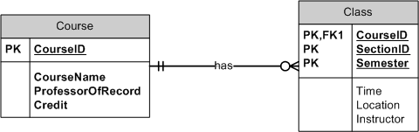
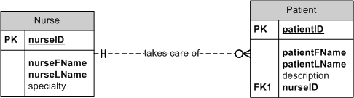
Identifying and non-identifying relationships
Notes:
Solid line vs. dotted line
In weak entity, the PK includes FK to other entities
In strong entity, the PK and FK are independent

Slide 25
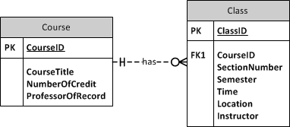
Surrogate Key changes identifying relationship to be non-identifying relationship
Using surrogate key may hide the dependency relationship
Surrogate key
Candidate key
Notes:
Identifying relationship at the top
Non-identifying relationship at the bottom
The combination of CourseID, SectionNumber, and Semester should be unique. Using surrogate key hide that.

Slide 26
Composite Key V.S. Surrogate Key
 | Concept | Pros | Cons
Composite Key | Borrow parent table’s primary key as part of the child’s primary key | Identify the identifying relationship with explicit dependency Consistent update | A long key (if there are many parents, or one parent has a long composite key) Change in any parent key has to be updated (e.g. using another attribute as parent’s primary key)
Surrogate Key | Serial number auto generated for the child table | Simple implementation Changes in parent’s key won’t affect the child | the corresponding parent field in the child table may not be implemented as a foreign key, then there could be bad parent value in the child table Even with the foreign key constraint implemented, there could be duplicate pairs (parent, child) that are against the identifying relationship
Notes:
http://www.agiledata.org/essays/keys.html
The fundamental issue is that keys are a significant source of coupling within a relational schema, and as a result they are difficult to change. The implication is that you generally want to avoid keys with business meaning because business meaning changes. Having said that, I have a tendency to use natural keys for lookup/reference tables, particularly when I suspect that the key values won't change any time soon, as I describe below. Fundamentally, there is no clear answer as to whether or not you should prefer natural keys over surrogate keys, regardless of what the zealots on either side of this religious argument may claim, and that your best strategy is be prepared to apply one strategy or the other whenever it makes sense.

Slide 27
In class exercise – Identifying Relationship
Customer have bank accounts, and each account has a series of transaction records.
Customer → Bank Account → Transaction
Notes:
Just model accounts and transactions

Slide 28
ER Model:
Unary Relationship

Slide 29
Unary relationships
Is friend of
Facebook User
Is married to
Person
manages
Employee

Slide 30
Unary relationship (→ Binary Relationship)
is friend of
Facebook User
Facebook User
Unary relationship is a special kind of binary relationship in which the two associated entities are the same.

Slide 31
Cardinality constraints of unary relationships
Facebook User
Facebook User
Facebook User
Facebook User
Facebook User
Add as friend
Facebook User
Is added as friend

Slide 32
Cardinality constraints of unary relationships
Facebook User
Friends

Slide 33
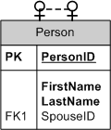
Unary relationships (1:1)
Person
Is married to

Slide 34
Modeling unary relationship in ERD (1:1)
Marriage relationship
Symmetric relationship
Questions:
Why should the FK attribute be optional?
Any problem with this solution
E.g. when there are more attributes in the Person entity?

Slide 35
Cardinality constraints of unary relationships (1:M, asymmetric)
Employee
Manages

Slide 36
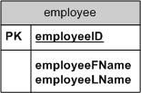
Modeling unary relationship in ERD (1:M, asymmetric)
Employee manages other employee(s)

Slide 37
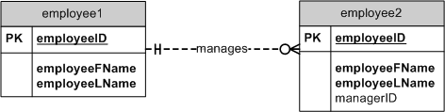
Modeling unary relationship in ERD (1:M, asymmetric)
Employee manages other employee(s)
Notes:
FK on the M side

Slide 38
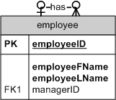
Modeling unary relationship in ERD (1:M)
Employee manages other employee(s)

Slide 39
Modeling unary relationship in ERD (1:M)
Employee manages other employee(s)
eID | Fname | Lname | managerID
8 | Arthur | Smith | 4
4 | Terry | Wind | 2
2 | Kelly | Hill | 1
1 | John | Weiss
Because the cardinality constraint on the many side is optional, the foreign key value can be empty.

Slide 40
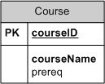
Modeling unary relationship in ERD (M:N)
Course requires other course(s)
e.g. courses 311, 322, 411, 511,422, 522
311 is prereq for 411, 422
311 and 322 are prereqs for 422

Slide 41

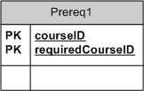
Modeling unary relationship in ERD (M:N)
Course requires other course(s)

Slide 42
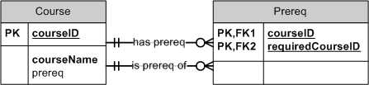
Modeling unary relationship in ERD (M:N)
Course requires other course(s)
Notes:
Use the example to show why one prereq only corresponds to one and only one course that requires the prereq.

Slide 43
More on 1:1 unary relationships
Person
Is married to

Slide 44
Attributes on 1:1 unary relationships
Marriage Certificate
Person
Person
Person
PersonID
FirstName
LastName
SpouseId
CertificateID
HusbandID
WifeID IssueOffice
IssueDate
MarriageCertificate
CertificateID
HusbandID
WifeID IssueOffice
IssueDate
An associative entity is introduced to reduce redundancy

Slide 45
Associative Entity of unary relationships
Marriage Certificate
Person
Person
Person
PersonID
FirstName
LastName
MarriageCertificate
PK CertificateID
FK HusbandID
FK WifeID IssueOffice
IssueDate
Person
PersonID
FirstName
LastName

Slide 46
Additional attributes on unary relationships
MarriageCertificate
PK CertificateID
FK HusbandID
FK WifeID IssueOffice
IssueDate
Marriage Certificate
Person
Marriage history?

Slide 47
Additional attributes on unary relationships
MarriageCertificate
PK CertificateID
FK HusbandID
FK WifeID IssueOffice
IssueDate
Marriage Certificate
Person
Marriage history?

Slide 48
Attributes on Unary relationships 1:M
MarriageCertificate
PK CertificateID
FK HusbandID
FK WifeID IssueOffice
IssueDate
Marriage Certificate
Person
An associative entity can also enable representing different cardinality constraints.

Slide 49
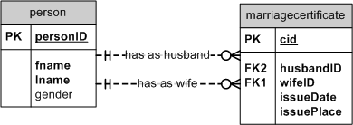
Attributes on unary relationship

Slide 50
In class exercise – unary relationship
In assembly line, some parts may consist of several other parts, but some parts don’t. For example, a wheel has a tire and many spokes. A tire does not have any components.
Notes:
One part contains zero or more parts, and one part is contained in zero or more parts. (associative entity)
One part contains zero or more parts, and one part is contained in zero or one part. (optional FK ParentPartID)

Slide 51
ER Model:
Ternary relationship

Slide 52
Ternary Relationship
Patient
Doctor
Medicine
prescribes

Slide 53
Cardinality constraints of ternary relationships
Patient
sends
contains
gives
Prescription
Doctor
Medicine
Simple case: assuming one prescription includes only one kind of medicine

Slide 54
Cardinality constraints of ternary relationships
Patient
receives
contains
gives
Prescription
Doctor
Medicine
Simple case: assuming one prescription includes only one kind of medicine

Slide 55
Cardinality constraints of ternary relationships
Patient
receives
Prescription
PrescriptionID
PatientID
DoctorID
MedicineID
Date
contains
gives
Doctor
Medicine
Simple case: assuming one prescription includes only one kind of medicine

Slide 56
Cardinality constraints of ternary relationships
Patient
receives
uses
gives
Prescription
Doctor
Medicine
What if doctors give multiple kinds of medicine?

Slide 57
Cardinality constraints of ternary relationships
Patient
receives
gives
Prescription
contains
Doctor
Medicine
one prescription may contains one or more kinds of medicine

Slide 58
Attributes on ternary relationship
Patient
receives
gives
Prescription
PrescriptionID
Date
PatientID
DoctorID
MedicineID
Doctor
PrescriptionItem
PrescriptionID
MedicineID
Instruction
Medicine

Slide 59
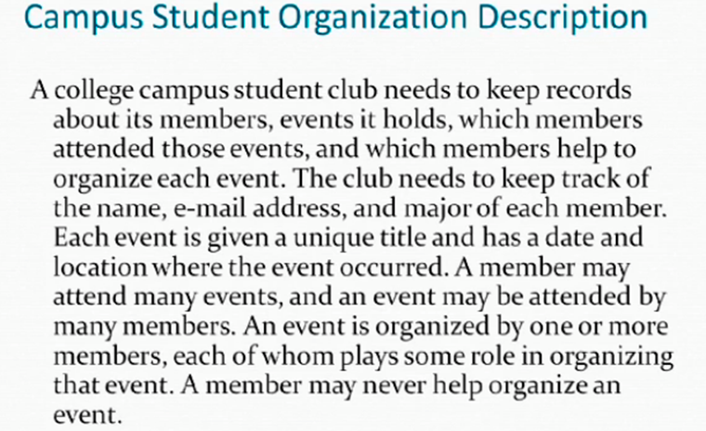
In class exercise – Data Model
Model: a member plays a role in organizing an event.

